Slide 1

Tasty Recipes Knowledge Graph
Group 5: Vaaruni, Zufeshan, and Chris
University of California, San Diego | December 9th, 2023

Slide 2
Contents
1
Application Introduction and Significance
2
Data Sources and Roles
3
Need for Data Integration
4
Data Integration Process
5
Knowledge Graph (Structure and Content)
6
Query Demonstrations

Slide 3
Application Introduction and Significance

Slide 4
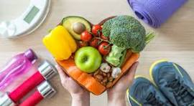
Project Background
Food is a major part of our daily lives, it speaks to our culture, fuels our bodies, and serves as a central necessity for building community.
We aim to make a knowledge graph with nodes of recipes, ingredients, cluster groupings, and instructions to allow users to quickly query for recipes within a central database that will fit their needs/cravings, or to replace ingredients with-in recipes to suit users’ preferences (Ex: Vegan, Vegetarian, Healthy, Japanese, etc.). Beyond this, we are integrating health data that allow users with certain health conditions to receive catered results pertaining to avoiding certain foods.
Photo source: istockphoto.com

Slide 5
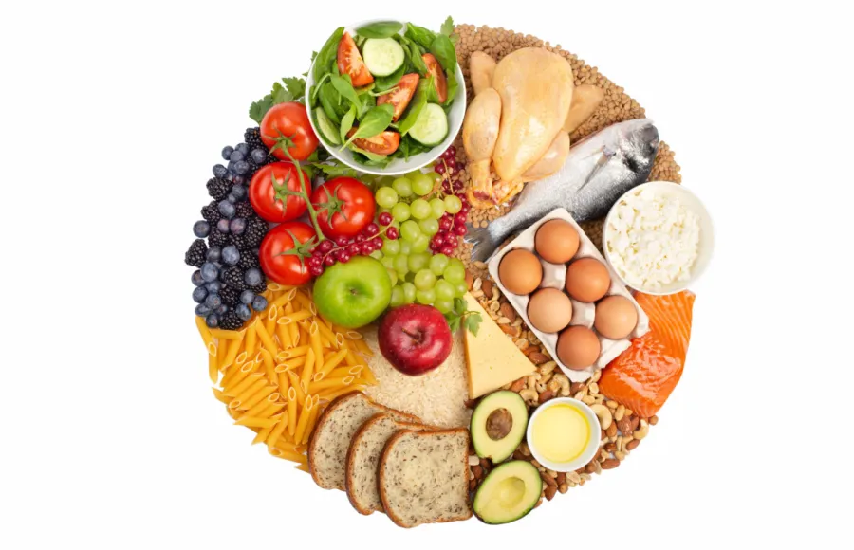
Our Proposal
Create an application that would allow:
User to query recipes based on their desired dietary preferences
User to make adjustments to recipes based on desired dietary preferences or health conditions
Suggest to user recipes using user provided ingredients and desired dietary preferences
Photo source: womensfitness.co.uk

Slide 6

Our End User
End-users:
Hospitals
Somebody on a diet
Somebody looking to manage their health conditions through diet
Restaurants looking to cater to expanded population by introducing vegan alternatives
Photo source: istockphoto.com

Slide 7
Data Sources and Roles
Notes:
Zufeshan starts here

Slide 8
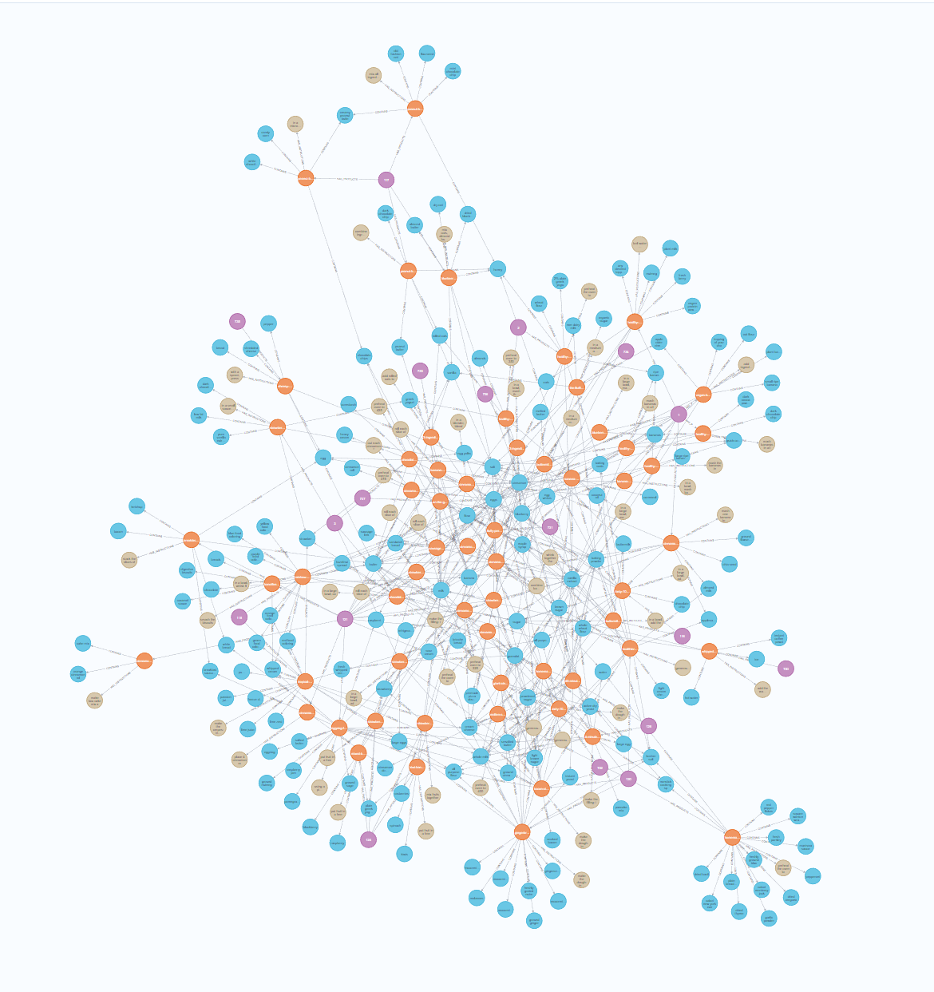
Our Data
Kaggle Datasets - (Source: https://www.kaggle.com/datasets/zeeenb/recipes-from-tasty | Tasty’s API)
dishes.csv [semi-structured and unstructured data] ~5k rows
Ingredients_and_instructions.json [semi-structured and unstructured data] ~5k rows
USDA Datasets [relational tables] (Source: SDSC Nourish Database)
usda_2022_food_branded_experimental: ~1M rows
usda_2022_branded_food_nutrients ~21M rows
usda_2022_branded_food_product ~1M rows
usda_2022_nutrient_master ~500 rows
Internal Datasets:
Vegan Substitute [semi-structured, dummy data] - 10 rows
Disease Nutrient-Avoidance [semi-structured, dummy data] - 10 rows
Maximum Nodes (300) Displayed

Slide 9
Data Integration Requirement

Slide 10

Need for Data Integration
We want to build an application by extracting selective information from different sources (Tasty, SDSC, internal data), transforming them as needed, and combining them into a new data object so that the user may query
Converting from semi-structured to structured and joining on shared key
Pre-processing and joining data structured data based on value matching (fuzzy matching unstructured keywords – #tagging the products)
Integration process will be a mix of materialized and virtualized and occur with centralized processing
Notes:
Information integration is the task of constructing a new data resource for a specific problem or application by extracting selective information from multiple data sources, transforming them as needed and then combining them into new data objects.

Slide 11
Data Integration Process

Slide 12
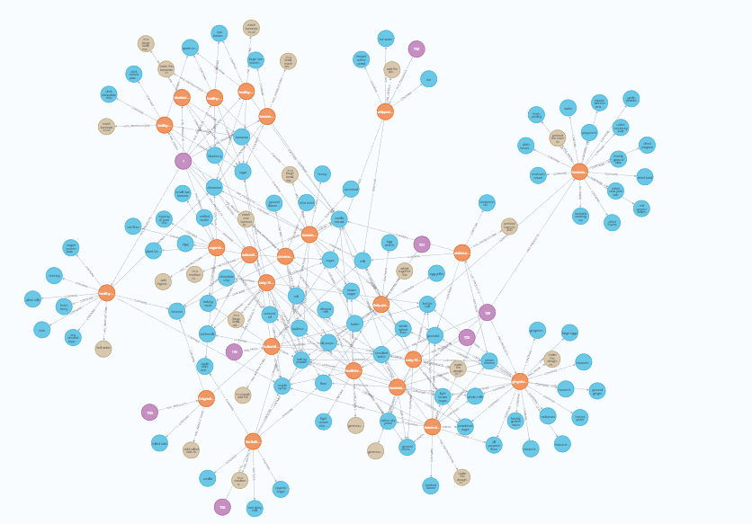
Data Integration Process
Parsing json elements, extract relevant fields
Merging extracted data together into a dataframe
Entity Resolution using dedupe clustering to categorize the products based on product name
Extract keywords from the product name to form cluster keywords (grabs 2 most common keyword occurrences)
Join USDA relational tables based on fdc_id, filtering by user input, selecting columns relevant to Tasty Dataframe
Create knowledge graph out of Tasty Data and USDA Data
Frame Cypher queries and return desired outputs
Processing results with OpenAI prompt(gpt-4) to return instructions and ingredients in a format desirable to end user
Notes:
Use pandas.read_csv() to load dishes.csv into dataframe
Use json to load ingredients_and_instructions data, and then use jsonpath to parse resulting, before loading it into pandas dataframe
Perform JSON Data Transformation (extraction, loading, and cleaning):
Extract list of ingredients per product (aggregation function)
Extract instructions per product (aggregation function)
Merging extracted JSON Data into pandas dataframe and join the

Slide 13
Knowledge Graph
Structure and Content(Structure and Content)
Notes:
Vaaruni starts here

Slide 14
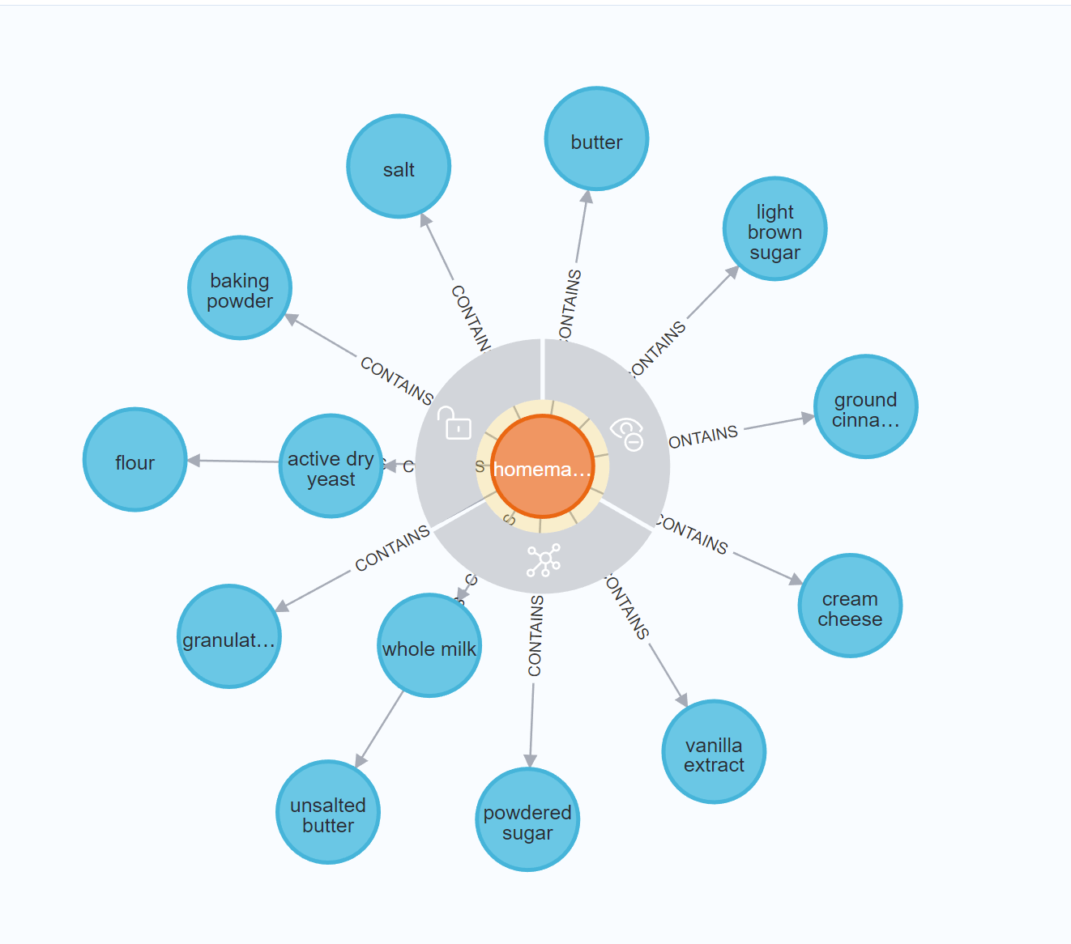
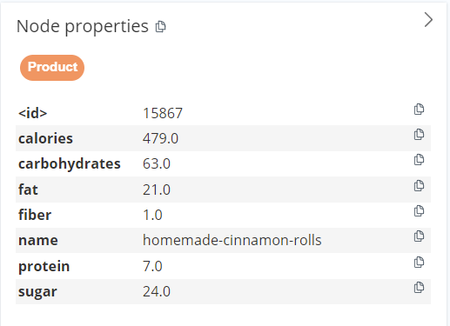
Knowledge Graph: Nodes, Node Properties
Product
Properties: {<id>, calories, carbohydrates, fat, fiber, name, protein, sugar}
Ingredient
Properties: {<id>, name}
Cluster
Properties: {<id>, keywords, name}
Instructions
Properties: {<id>, instructions}

Slide 15
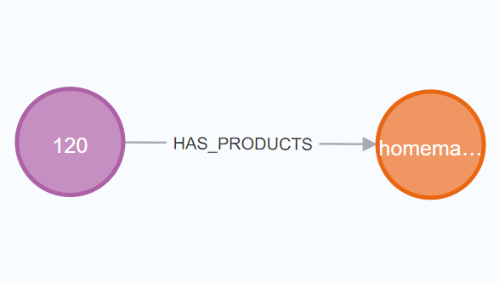
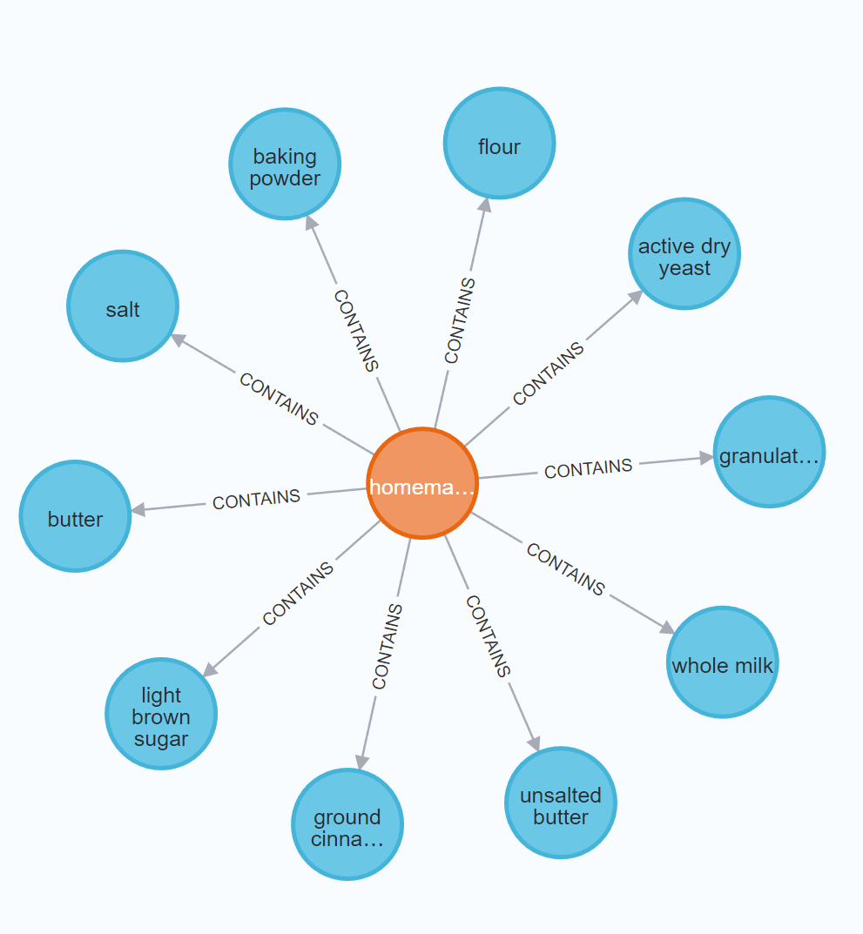
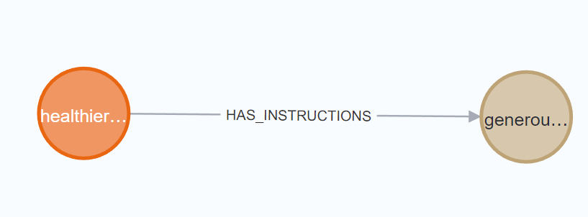
Knowledge Graph: Edges, Edge Properties
HAS _PRODUCTS
Direct from Cluster (C) to Product (P)
1:N Relation
CONTAINS
Direct from Product (P) to Ingredient (I)
N:M Relation
HAS_INSTRUCTIONS
Direct from Product (P) to Instruction (J)
1:1 Relation

Slide 16
Query Demonstration

Slide 17
Query One
User asks: “I have vegan margarine, soy milk, sunflower oil, plain flour, caster sugar, baking powder, and salt at home. Can you suggest a quick recipe to make a dish out of this?”
Process
search for products that contain all the ingredients provided by the user
sorts the products based on number of sentences in the instructions
returns the recipe with least number of sentences
Cypher query will return a quick recipe using all ingredients, in this instance, Vegan Donuts

Slide 18
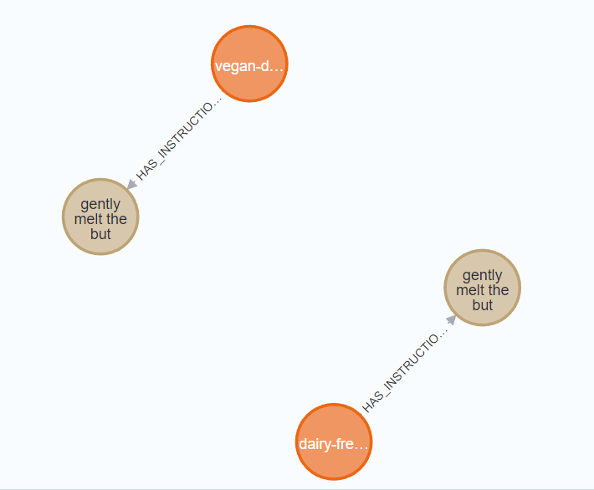
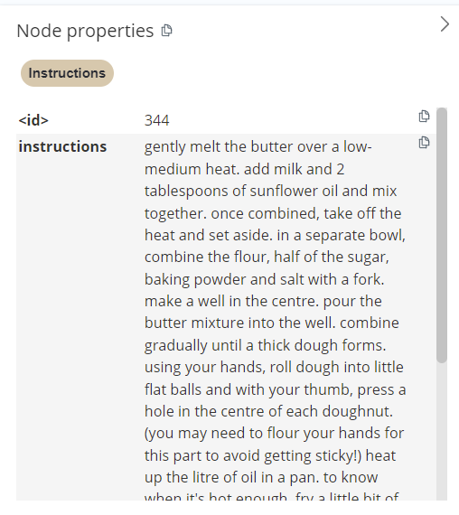
Query One: Output, Graph Result
Example Output:
With the ingredients provided, you can make VEGAN DOUGHNUTS. These are the instructions to prepare - gently melt the butter over a low-medium heat. add milk and 2 tablespoons of sunflower oil and mix together. once combined, take off the heat and set aside. in a separate bowl, combine the flour, half of the sugar, baking powder and salt with a fork. make a well in the center and pour in the butter mixture. combine gradually until a thick dough forms. using your hands, roll dough into little flat balls and with your thumb, press a hole in the center of each doughnut. (you may need to flour your hands for this part to avoid getting sticky!) heat up oil in a pan. to know when it's hot enough, fry a little bit of bread in the oil. if it goes brown and floats to the top, in 45-50 seconds the oil will be ready! gently lay the doughnuts into the oil using a spatula. fry for about 3-5 minutes on each side, until golden brown. transfer the doughnuts onto some tissue paper to soak up any excess oil. roll the doughnut into a bowl of the remaining half of sugar. enjoy!

Slide 19
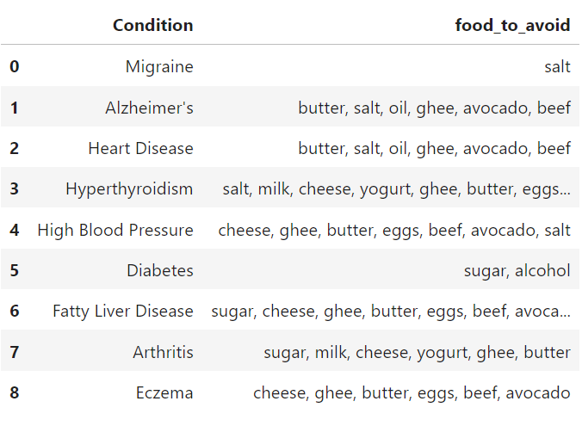
Query Two
User asks: “I am a diabetes patient. Help me make some cheesecake while keeping my diabetes in mind”
Process
searches for clusters with keywords that contain the product_to_make
for all the products under each cluster, removes the ingredient that the user needs to avoid based on the given condition
for example - A diabetic patient needs to avoid sugar/alcohol
sorts the products in ascending order based on calories
gives the user option to choose between the 3 healthiest products
provides the user with ingredients to use and instructions to make the chosen product
Cypher query will return the cheesecake recipe, modified to avoid the ingredients linked to symptom flare-up.

Slide 20
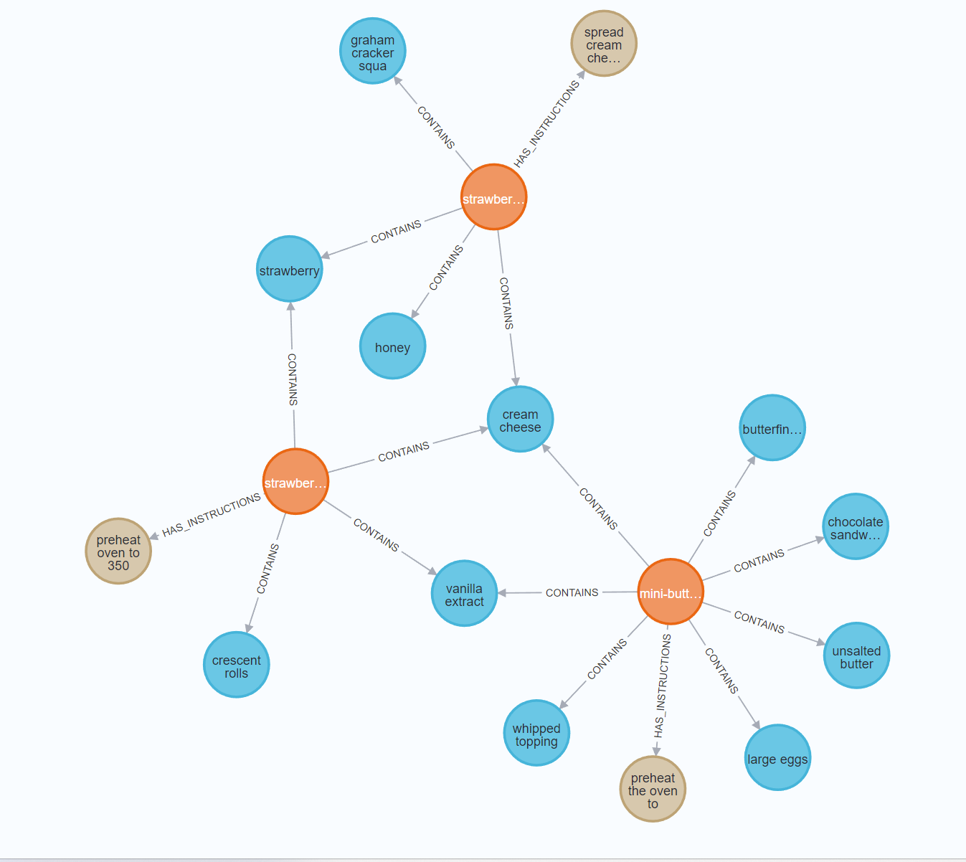
Query Two: Graph Result, Output
I have 3 recipes which are less in calories. Please pick one recipe among
mini-butterfinger-cheesecakes, strawberry-cheesecake-crackers, strawberry-cheesecake-crescent-rolls
user input: strawberry-cheesecake-crackers
Ingredients to use : ['graham cracker squares', 'cream cheese', 'strawberry', 'honey']
Instructions to make strawberry-cheesecake-crackers - spread cream cheese onto each graham cracker. top with strawberries. drizzle with honey. enjoy!

Slide 21
Query Three
User asks: “I want to make healthy pancakes. Can you give me a recipe?”
Process
searches for cluster_keywords that contain the product provided by the user
gets the products under these clusters that contain the search_substring
sorts them in ascending order based on calories
returns the 3 healthiest recipes
Cypher query will return the pancake recipes deemed the healthiest by nutrient profile.
OpenAI finely curated prompts used to summarize group of (3) recipes into one and return it as user-friendly, formatted instructions and ingredients.
Notes:
Zufeshan here

Slide 22
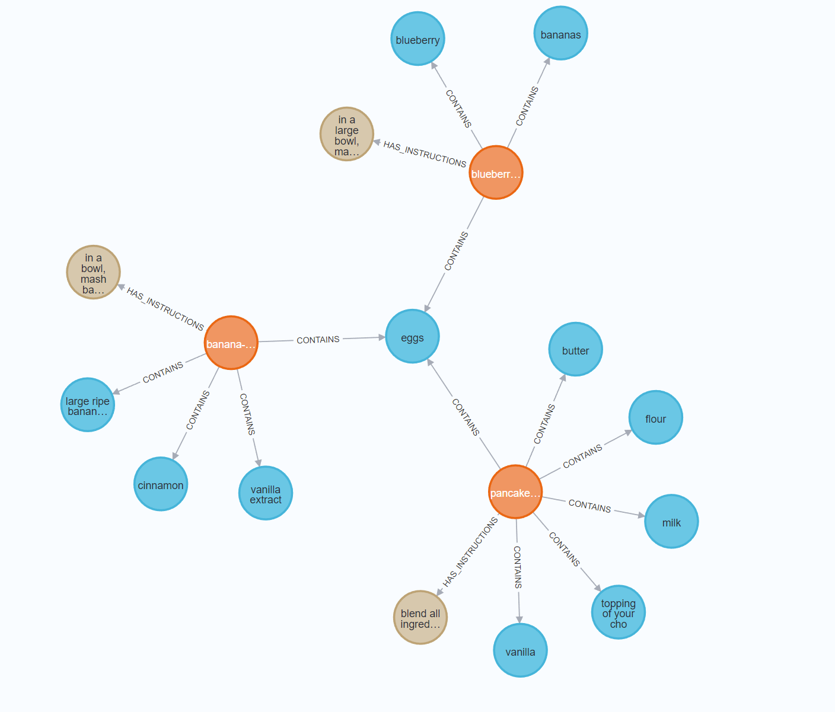
Query Three: Graph Result, Output
Ingredients required - ['bananas', 'blueberry', 'butter', 'cinnamon', 'eggs', 'flour', 'large ripe bananas', 'milk', 'topping of your choice', 'vanilla', 'vanilla extract']
Instructions to prepare - To make pancakes, start by mashing bananas in a large bowl until they reach a liquid state. Then, whisk in the eggs. Heat butter in a large skillet over medium heat. Pour the batter into the warm skillet and garnish with blueberries. Cook for about a minute and a half or until golden, then flip to finish cooking. Allow to cool for a minute before serving. Enjoy your pancakes!

Slide 23
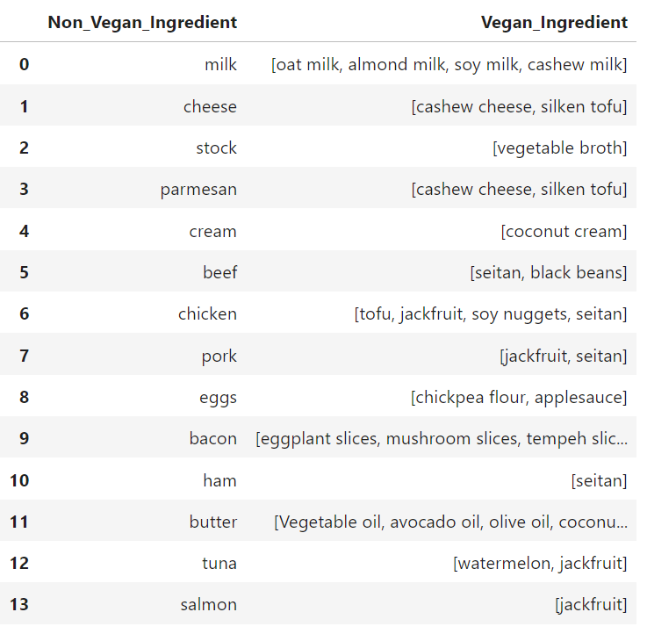
Query Four
User asks: “Please give me the vegan substitute of healthier chicken alfredo pasta”
Process
gets the vegan substitutes data
searches for non-vegan-product in the products
gets the ingredient list and instructions for the non-vegan product
using the vegan substitutes data, replaces the non-vegan ingredients with vegan ingredients
returns the instructions for the new vegan product
Cypher query will return a vegan version of healthier chicken alfredo pasta

Slide 24
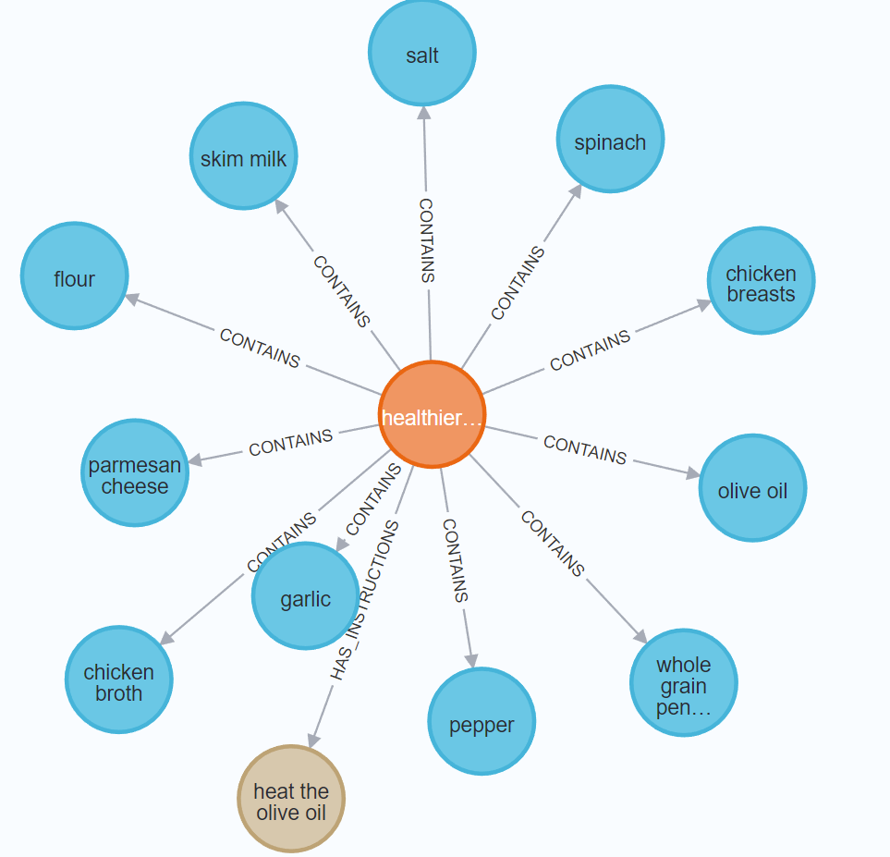
Query Four: Graph Result, Output
Recipe to make the vegan version of chicken alfredo pasta is
- heat the olive oil over a skillet and add tofu. season with salt and pepper, and cook 5-8 minutes. remove the tofu from the pan and set aside. in the same pan, add the garlic and saute for one minute over medium heat. sprinkle the flour over the garlic and slowly add in the vegetable stock. quickly stir to avoid lumps. add in the skim oat milk, stir ,and allow to reach a boil to thicken sauce. season with salt and pepper. once the sauce is thickened, add in the spinach and stir until wilted. remove from heat and add in the cooked penne, tofu, and cashew cheese. stir to coat. top with fresh cashew cheese. enjoy!

Slide 25
Query Five
User asks: “I'm craving for something delicious, give me options for heart-disease-friendly recipes."
Process
get the list food items to be avoided by a user with given health condition
unwind the list of food items
check for products that don't contain any of the items that need to be avoided
group the products based on the number of duplicate records
return the recipes of the products who have duplicate number of records = the length of the food items to avoid list
order data by fiber content since fiber is good for all health conditions
return the top 5 recipes to the user
Cypher query return 5 recipes that avoids the nutrients associated with heart-disease symptom flare-up
Notes:
Chris here

Slide 26
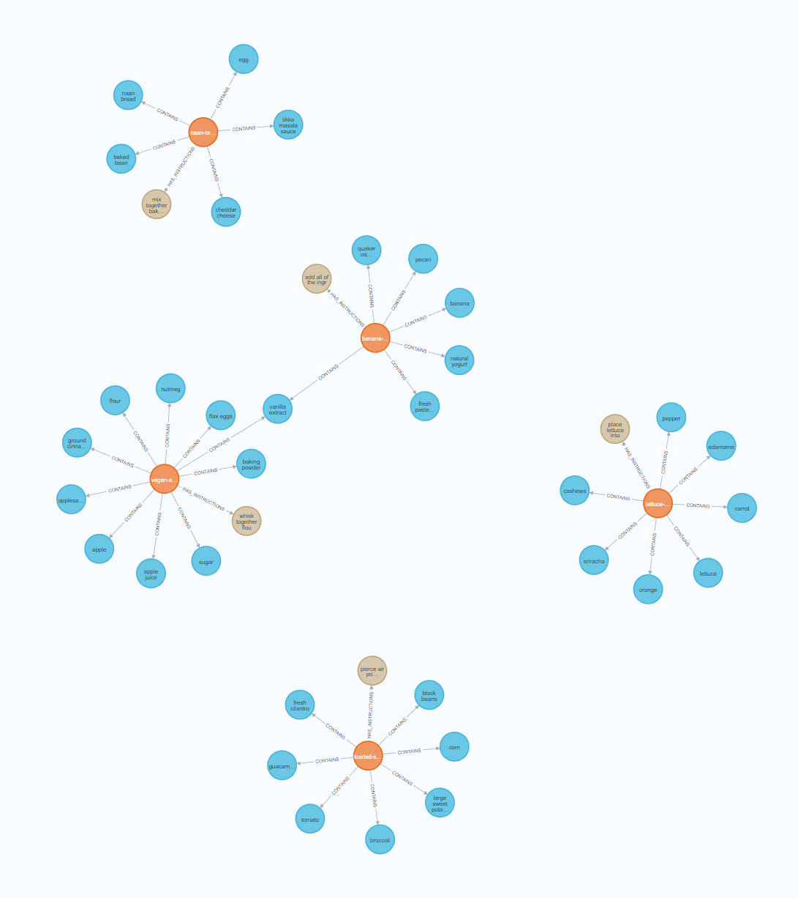
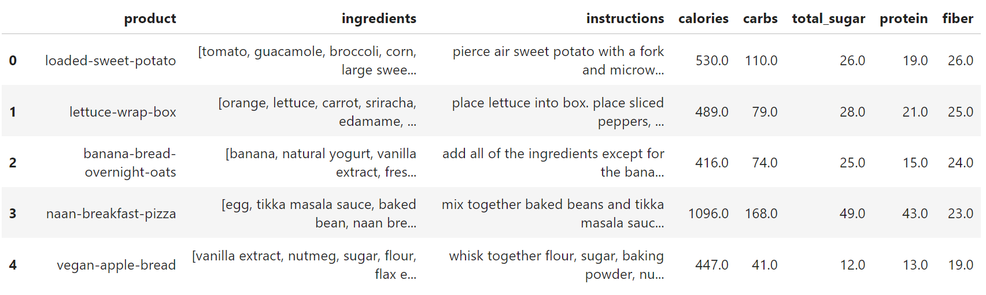
Query Five: Graph Result, Output

Slide 27
Future Work

Slide 28
Future Work
Cut healthcare costs associated with nutrition matching
Hospitals spend, on average, 268$ per patient, per day on food
Use metric-unit data to incorporate exact measurements of each ingredient
Use more advanced techniques to do entity resolution (for eg - blocking techniques, entity matching, clustering)
Improve suggestions by expanding food nutrition profile
Use of data/knowledge graph by popular food logging applications

Slide 29
Questions?

Slide 30
Thank you!

